Slide 1


AIRLINE
RESERVATION SYSTEM
FEEL THE MILES...
Group Members:
13- Anish Chavan
16- Shreya Dalvi
26- Sadhana Gawali
46- Swayamsiddha Mane Deshmukh

Slide 2
INTRODUCTION
Users access an airline's inventory through an availability display.
It contains all the offered flights for a particular city-pair in the different booking classes.
Reservations for individual passengers or groups are stored in a PNR.
System can perform tasks such as filtering out available flights, cashless payment system and making bookings in an effective manner.
No formal knowledge from the user is required. This makes the software more user-friendly.

Slide 3
PROBLEM STATEMENT
Implement an airline reservation system to book tickets online, get the details of the flight arrival, select the class they want to choose, and reserve seats for national or international flights.

Slide 4
PROJECT OVERVIEW
Purpose is to create an airline reservation system that allows users to search for flights, reserve flights, track flights, cashless payment, and download the boarding pass.
The project is designed to display available flights, reserve a ticket via cashless payment methods.
User can download a softcopy of the boarding pass.
The system allows users to track flights using their PNR number and name.
Flight details are displayed in the flight tracking section.

Slide 5
SOFTWARE REQUIREMENTS
Operating System: Windows 98, Windows XP, Windows7, Linux
Language: J2EE (Java), JavaScript
Technologies used: Java Server Pages, SQL
Database: MySQL Server
Browser: Any of Mozilla, Chrome, MS Edge, etc.
Web Server: Apache Tomcat 10
Software Development Kit: Java Development Kit (JDK) 1.7 or Above
Database Drivers: MySQL Connector

Slide 6
SYSTEM WORKFLOW
Search Flights
Enter source, destination, date and class
Select flight from the available flights
Enter Traveller Information
Enter payment information
Complete Payment Process
Download the payment form of the ticket

Slide 7
SYSTEM WORKFLOW
Track flights
Enter name and PNR number
Get flight details

Slide 8
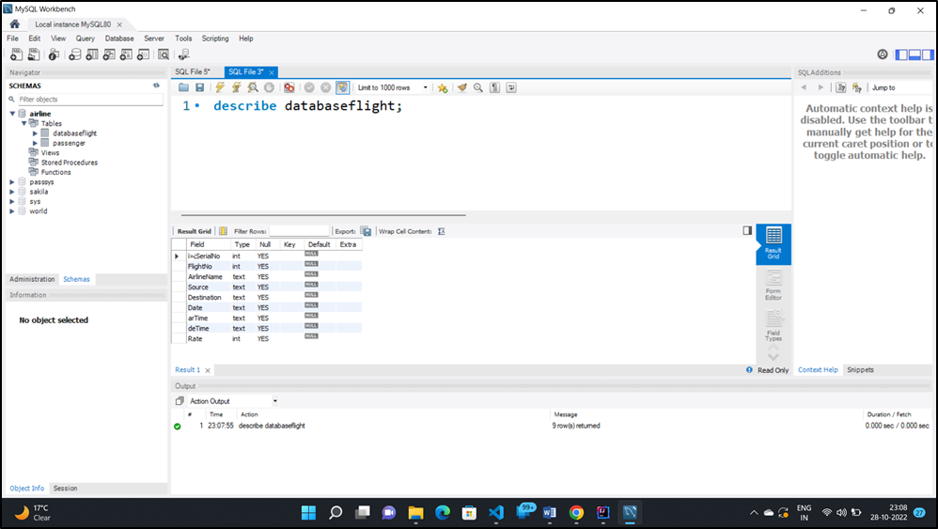
DATABASE : MYSQL
AIRLINE RESERVATION AND TRACKING

Slide 9
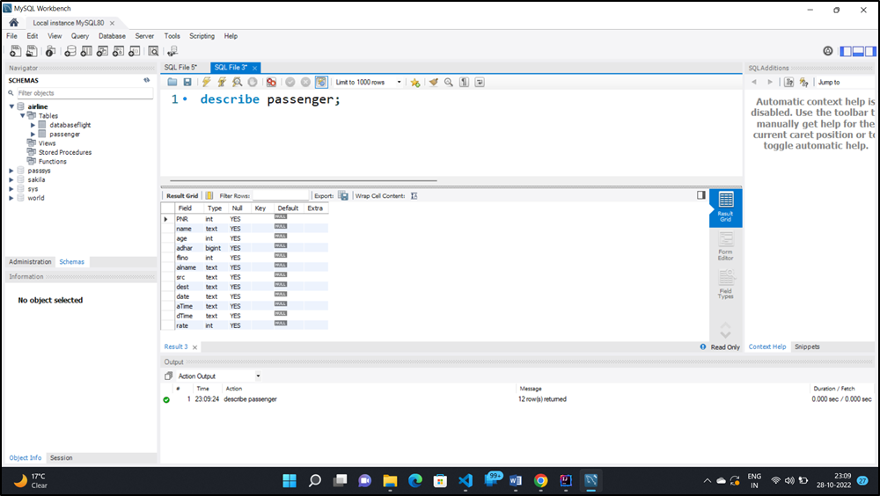
DATABASE : MYSQL
AIRLINE RESERVATION AND TRACKING

Slide 10
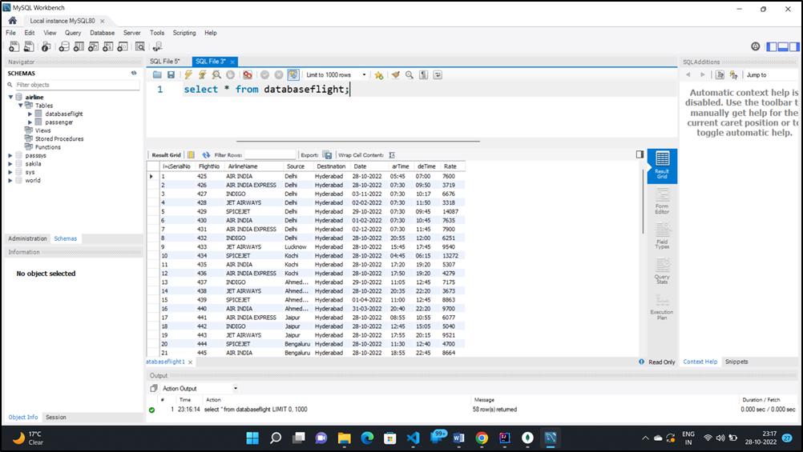
DATABASE : MYSQL
AIRLINE RESERVATION AND TRACKING

Slide 11
ADVANTAGES
Online payment gateway that is secure
Online reservations that are seamless, quick, and error-free
User-friendly interface
Saves time and money
Tickets can be downloaded and accessed from any location
Provides every detail about the flight
24/7 booking is available
Available for both domestic and international airlines

Slide 12
DISADVANTAGES
Excel export has not been developed for airline tickets or flights due to some Criticality.
The transactions are executed in off-line mode,
Off-line reports of airline tickets, booking counters, and bookings cannot be generated due to batch mode execution.

Slide 13
FUTURE SCOPE
Maintaining information regarding the availability of seats, round-trip reservations, preferred seat choices.
Host the platform on online servers to make it accessible worldwide.
Create a master and slave database structure to avoid database query overload.
Implement the backup system.
Enhancements may be made to keep all airline tickets, flights, bookings, customers, and the booking counter in good working order.

Slide 14
CONCLUSION
It is concluded that we have made an effort on the following points:
System's requirements specifications and the actions that can be taken in response to them. ▪
Problem domain and model of the system, which describes operations that has been performed in the system.
Features and operations in detail, including screen layouts.
The user interface and security issues related to the system.
Finally, the system is successfully implemented and tested according to test cases.

Slide 15
THANK YOU!!

